Slide 1
Small Business Training
1 - Introduction

Slide 2
Small Business Training
Aims
This course aims to ...
Enable you to run your own successful and sustainable businesses.

Slide 3
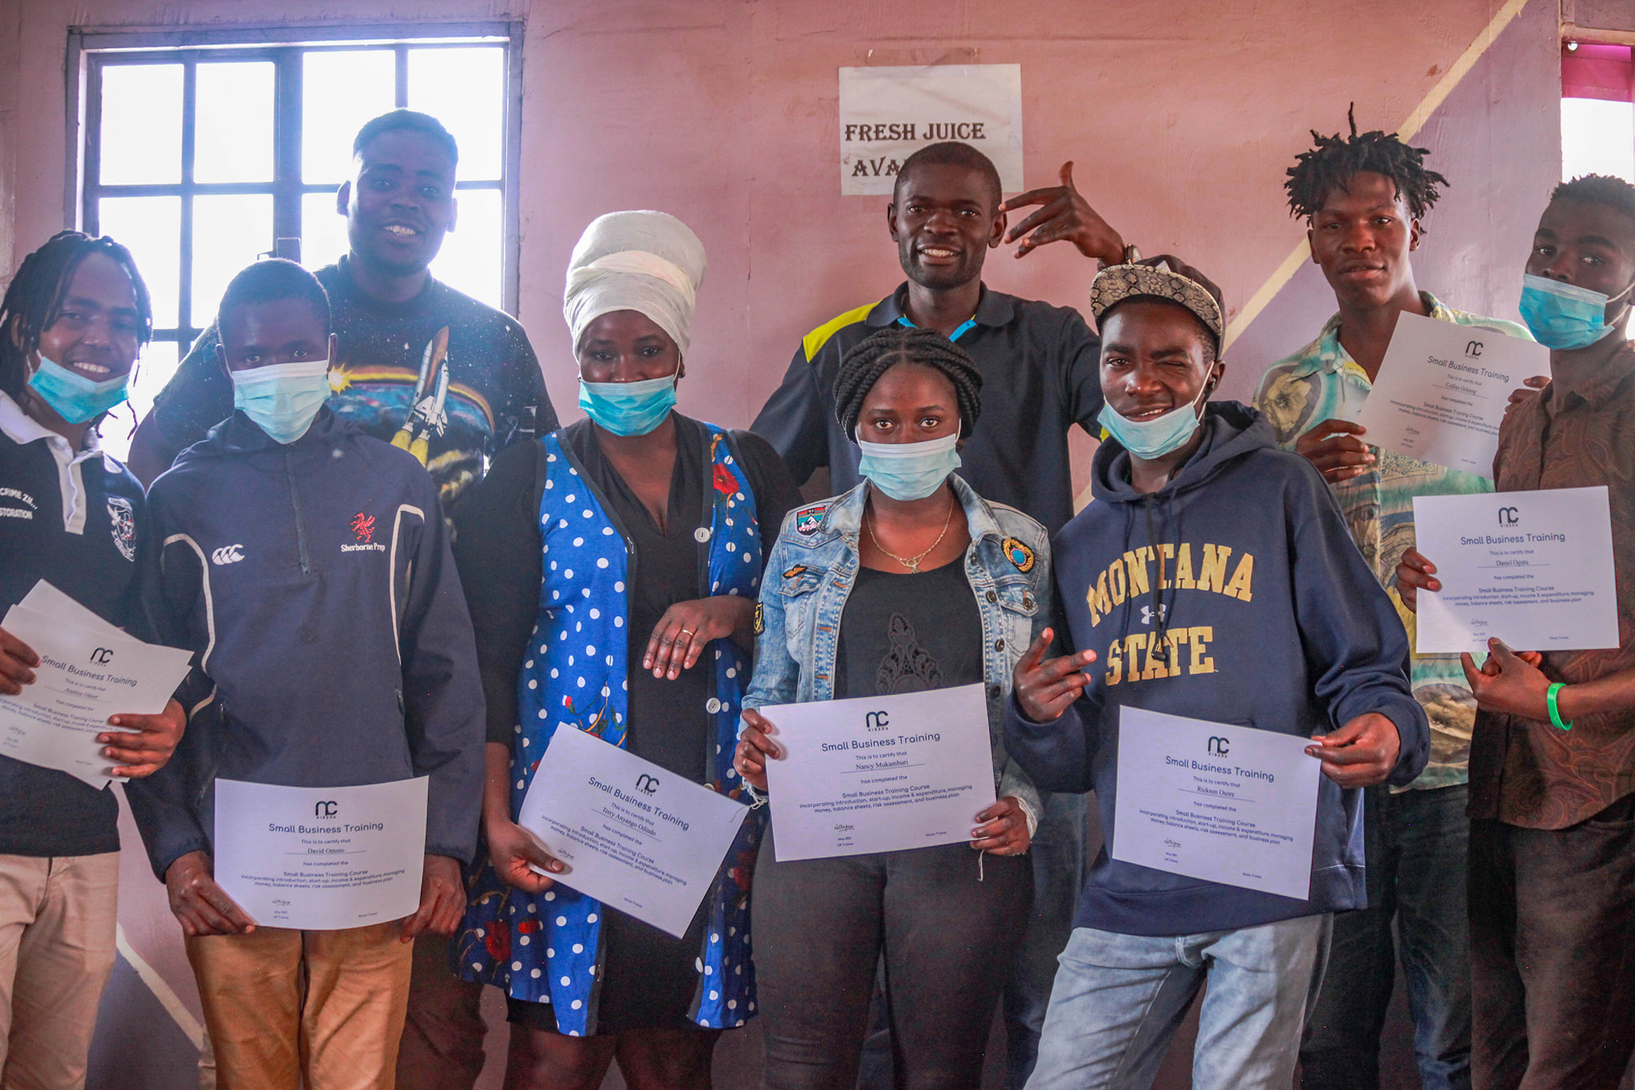
Small Business Training
Course Topics
Over 12 lessons we’ll cover ...
Getting started
Income and expenditure
Managing money
Managing risk
Writing a business plan
Writing a business (loan) proposal
Unique selling point

Slide 4
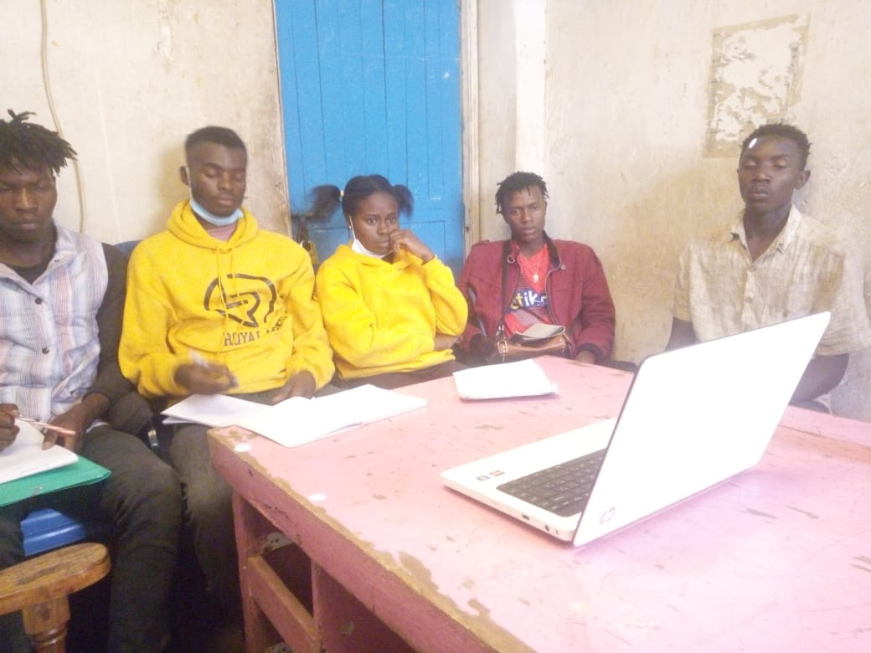
Small Business Training
Session structure
Each session will include ...
A short video lesson
Opportunity to discuss the lesson
Exercises (to do together and individually)

Slide 5
Small Business Training
Aims
Aims for today:
To understand the purpose and approach to the small business training course.
To understand, feel comfortable with, and be committed to the training programme.
To introduce some of the basic principles of running a small business.

Slide 6
Why have a business?
What do you want to achieve?
What are the advantages and disadvantages of owning your own business (as opposed to working for someone else)?

Slide 7
What kind of business?
What can you do?
What are your skills?
What resources do you already have available to you?

Slide 8
Exercises
As a group make a list of the advantages and disadvantages of running your own business.
As a group make a list of the types of business that would work in your area.
As individuals think about what business you could set up yourself and why it could work.

