Slide 1
Small Business Training
5 - Balance sheets

Slide 2
Small business training
Balance sheets
Last week ...
Managing all your business money
Idea of money pots

Slide 3
Small business training
Balance sheets
This week ...
Develop our money pots into balance sheets

Slide 4
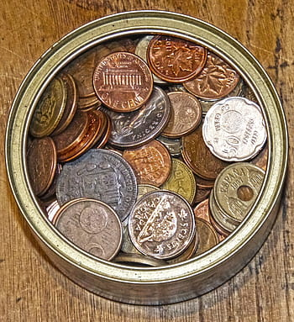
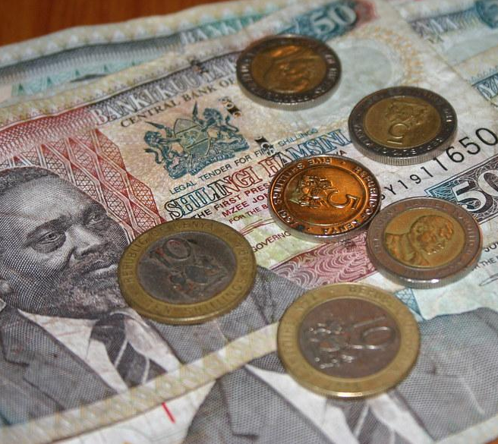
Money pots
Weekly running costs
* electricity
* shop rent
* raw materials
Long term costs / savings
* replace tools
* new stock
* emergencies
* new equipment
* growing the business
Weekly personal income (wage)
* living expenses
* medical
* entertainment

Slide 5
Money pots - selling juice
Weekly running costs
electricity
water
mangoes
cups
TOTAL
100
100
1400
900
2500
Long term costs / savings
fridge
emergencies
TOTAL
700
700
Weekly personal wage
food
drink
accomodation
transport
TOTAL
200
200

Slide 6
Business money and personal money
Golden rule:
Keep business money separate from personal money
(Don’t spend the money you need to keep the business running on yourself)

Slide 7
Business money and personal money
Golden rule:
Business money
Personal money
Weekly running costs
Long term costs / savings
Weekly personal wage

Slide 8
Business earnings (income)
INCOME (money earned per week) Price of 1 cup juice - 20 KSh Estimate selling 40 cups per day Working 6 days per week Total weekly income = 20 x 40 x 6 KSh | 4,800

Slide 9
Business costs (expenditure)
EXPENDITURE (money going out of the business each week)
Weekly running costs (electricity, water, mangoes, cups) | 2,500
Long term costs / savings (fridge, emergencies) | 700
Personal wage (what you pay yourself) | 200
Total expenditure | 3,400

Slide 10
Income and expenditure balance sheet
INCOME (money earned each week by selling juice) |  | 4,800
EXPENDITURE Weekly running costs Long term costs / savings Weekly personal wage Total expenditure | 2,500 700 200 3,400 | 3,400
not the same

Slide 11
Income and expenditure balance sheet
INCOME (money earned each week by selling juice) | 4,800
EXPENDITURE Weekly running costs (2500 Ksh) Long term costs / savings (700 KSh) Weekly personal wage (1,600 KSh) | 4,800
the same
(balanced)

Slide 12
Group exercise
Write a balance sheet for the business you used as an example in the last session.
INCOME (money earned per week)
Earnings
Total weekly income
EXPENDITURE (money spent or saved per week)
Weekly running costs
Long term costs / savings
Personal wage
Total weekly expenditure
these should balance

Slide 13
Individual exercise
Write a balance sheet for your own business.
INCOME (money earned per week)
Earnings
Total weekly income
EXPENDITURE (money spent or saved per week)
Weekly running costs
Long term costs / savings
Personal wage
Total weekly expenditure
these should balance

