Slide 1
Small Business Training
8 - Unique Selling Point

Slide 2
Last week ...
This week ...
USP
Business plan
Unique Selling Point / Proposition (USP)
“What makes your business different?”
“Why should people buy from you?”

Slide 3
Unique Selling Point
USP
“every brand needs to define itself uniquely from the competition”
What makes you different?

Slide 4
Understand your customers
USP
Who are they or who do you want them to be?
What do they want from you?
What will make them come and buy from you rather than go to your competitors?
Describe your business with a strapline that will appeal to your customers.

Slide 5
Your strapline
USP
You MUST do what your strapline says
Examples:
Fruit juice - “always chilled”
Poultry farm - “fresh produce daily”

Slide 6
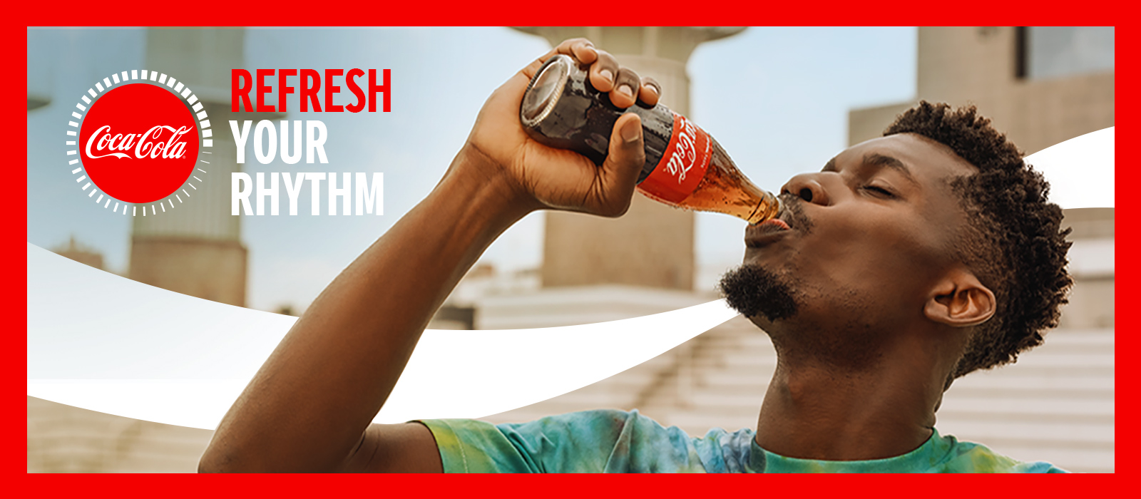
Example straplines
USP
“Twaweza: when we come together, great things happen.”
“the Pride of Africa”
“Refresh your rhythm.”

Slide 7
Example USPs
USP
connecting people to achieve good things
a strong global player in the aviation industry
“live the Coke side of life”
(aspirational lifestyle)

Slide 8
Example USPs
USP
 | Strapline | USP
 | “when we come together we can do anything” | connecting people to achieve good things
 | “The Pride of Africa” | a strong global player in the aviation industry
 | “Refresh your rhythm” | “live the Coke side of life” (aspirational lifestyle)

Slide 9
Today’s exercises
USP
As a group, make a list of well known companies with their straplines. For each write down what their USP is. (e.g. CocaCola “refresh your rhythm”, USP = refreshing drink.)
As individuals, decide what your business USP should be.

