Slide 1
Small Business Training
4 - Managing money

Slide 2
Small business training
Managing money
Last week ...
Calculate the start-up costs.
Weekly costs.
Income and expenditure.
Profit.

Slide 3
Small business training
Managing money
This week ...
Managing all your business money
Idea of money pots

Slide 4
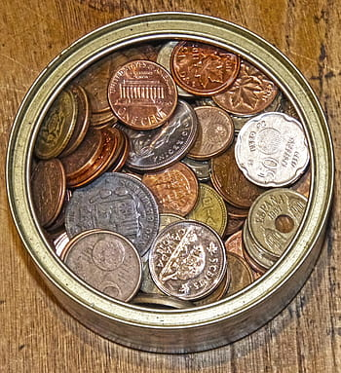
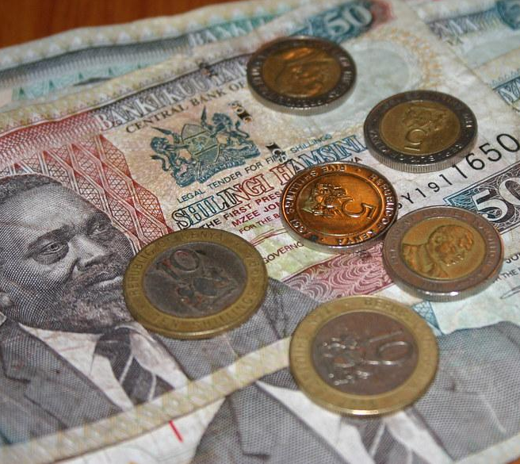
Money pots
Weekly running costs
Long term costs / savings
Weekly personal income

Slide 5
Money pots
Weekly running costs
* electricity
* shop rent
* raw materials
Long term costs / savings
* replace tools
* new stock
* emergencies
* new equipment
* business growth
Weekly personal income
* living expenses
* medical
* entertainment

Slide 6
Money pots - poultry farming
Weekly running costs
* chicken food
* housing rent
Long term costs / savings
* replace dead chickens
* more chickens
* more water tins
* bigger housing
Weekly personal income
* food
* drink
* accomodation
* transport
* entertainment
* medical

Slide 7
Money pots - milk vending machine (ATM)
Weekly running costs
* room rental
* milk
* electricity
Long term costs / savings
* theft of milk
* ATM repairs
* replacement ATM
* spoiled milk
* another ATM
Weekly personal income
* food
* drink
* accomodation
* transport
* entertainment
* medical

Slide 8
Money pots - selling juice
Weekly running costs
* electricity
* fruit (mangoes)
* cups
* laundry (coat)
Long term costs / savings
* theft of fruit
* theft of blender
* bad fruit
* replacement blender
* new white coat
* fridge
Weekly personal income
* food
* drink
* accomodation
* transport
* entertainment
* medical

Slide 9
Money pots - group exercise
As a group, think of a business and write down what things should be covered by each money pot and say how much money per week you would put into each pot.
Weekly running costs
*
*
*
Total KSh _______
(per week)
Long term costs / savings
*
*
*
Total KSh _______
(per week)
Weekly personal income
*
*
*
Total KSh _______
(per week)

Slide 10
Money pots - individual exercise
For your chosen business, write down what things should be covered by each money pot and say how much money per week you would put into each pot.
Weekly running costs
*
*
*
Total KSh _______
(per week)
Long term costs / savings
*
*
*
Total KSh _______
(per week)
Weekly personal income
*
*
*
Total KSh _______
(per week)

